Slide 1
The Road Ahead
(insert date)

Slide 2
Objectives
By the end of this lesson, you will be able to:
Interpret self-assessment results to identify development needs.
Plan for self-development using an abilities-knowledge-experience approach.
Develop a Professional Development Plan.

Slide 3
Prioritizing Development
Review your self-assessment worksheets
Also consider the lessons in the course without a self-assessment
Which three (or four) areas, if I improve, will yield my biggest results?
Record your answers on the Development Priorities Worksheet
Five (5) minutes – individual work

Slide 4
Small Group Discussion
In your small groups, answer the following questions:
What do you need to work on?
Why?
Expand your answers on the Development Priorities Worksheet
Five (5) minutes – be prepared to outbrief common areas

Slide 5
Large Group Discussion
What did you learn?
Are there any common themes or skills in your groups?
Why?

Slide 6
Planning for Personal Development
How can you get better?
Focus on:
Abilities
Knowledge
Experience

Slide 7
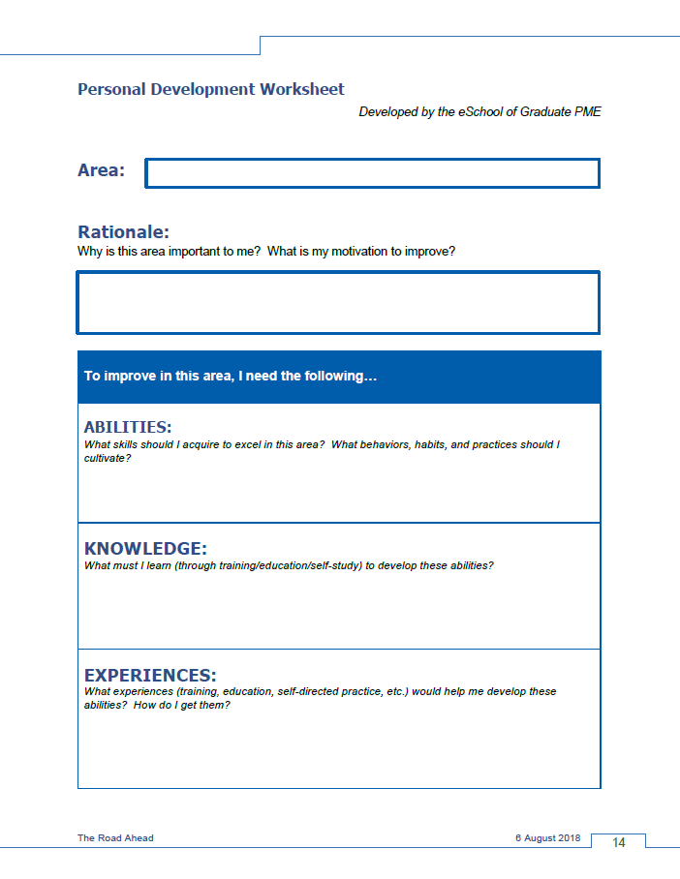
The Personal Development Worksheet
The Front →
Identifying Needs
Fill in
Desired area of improvement
Rationale for wanting to improve

Slide 8
The Personal Development Worksheet
The Front →
Identifying Needs
Fill in what you need to do
Abilities
Knowledge
Experience
Use the questions in each area to guide your answers and define your goals for improvement.

Slide 9
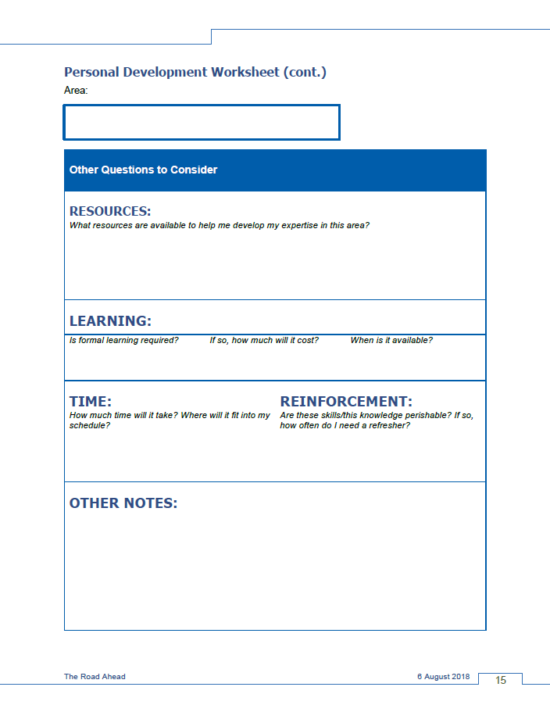
The Personal Development Worksheet
The Back →
Planning for Success
Consider what you need to succeed…
Resources
Learning (formal/informal)
Time
Use these prompts to define resources needed AND help you advocate successfully for training, funding, or time!

Slide 10
Small Group Activity
Take a moment to practice.
Fill out a worksheet for one of you’re your improvement areas
It doesn’t have to be perfect – just get ideas down on paper
Share your inputs
Gain insight from your peers
Five (5) minutes – individual work

Slide 11
How to Graduate from this Course
You must build your own
Professional Development Plan
Thise plan…
builds on the content of each leadership lesson,
helps you plan to improve your leadership strengths, and
provides an opportunity for feedback and mentoring.
To graduate, you MUST brief your commander (or equivalent) on your plan.

Slide 12
End-of-Course Survey
Thank you for your feedback!

